Slide 1
EVALUATION OF SLOPE STABILITY FOR WASTE ROCK DUMPS IN A MINE

Slide 2


Slide 3
Outline of the Presentation
Objective of the Study.
Methodology.
Literature Review.
Factors which Influencing Slope Stability of dump.
Modes of slope failure.
Slope Stability Assessment.
Input parameters for the Numerical Modeling.
Numerical models
Conclusions
References.

Slide 4
Objectives
The prime objectives of the project are addressed towards:
Evaluating stability of waste dump in an open cast mine
Optimizing the stability of dump slopes in an opencast mine using numerical models

Slide 5
Methodology
Extensive literature review has been carried out for understanding the different modes of slope failures.
Numerical model FLAC/Slope was critically reviewed for its application to evaluation of the stability of slopes.
Field investigations
Information/data has been collected from a case study of a mine, as well as from the literature.
Parametric studies have been conducted through FLAC/Slope to study the effect of cohesion and friction angle.

Slide 6
INTRODUCTION
Slope stability problem is the greatest problem faced by the open pit mining and civil engineering areas.
An understanding of geology, hydrology, and rock properties is the central to applying slope stability principles properly.
In slope stability analysis we determine the Factor of Safety as a ratio of resisting forces to driving forces
F_{s} = Resisting Force / Driving Force
Theoretically, any slope with a Factor of Safety less than one will fail and any slope with a factor of safety greater than one will not.
Design focuses on the rock slope parameters and geometry that will provide the maximum factor of safety.

Slide 7
Factors affecting slope stability of a dump
Geo technical parameters:
Grain Size Distribution of the waste rock (dump) material.
Atterberg limits like Liquid limit, Plastic limit ,Shrinkage limit and Plasticity index.
Co-efficient of permeability
Bulk density of dump mass
Shear strength parameters

Slide 8
Hydro-geological parameters influencing dump Slope Stability:
Effect on the shear strength parameters of dump materials due to water saturation during rainy season.
Upward thrust of water i.e. hydro-static force due to accumulated water table within the dump.
Seepage force of water due to accumulated water table within the dump.
Seepage due to surface drainage of water flowing through the gullies formed at the Surface of the dump.

Slide 9
Geo-mining parameters
Mine floor inclination
Seismicity of the area and blast vibration of quarry on the dump
Profile of the dump

Slide 10
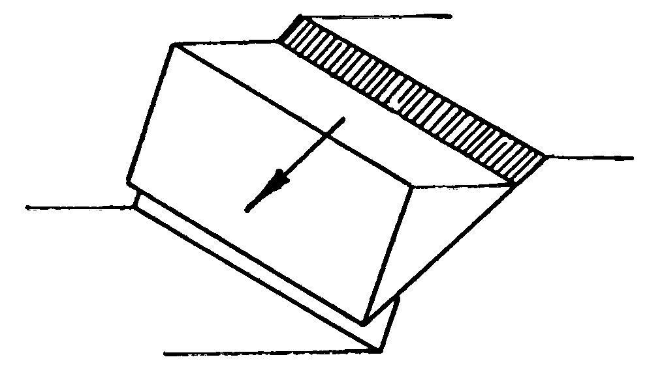
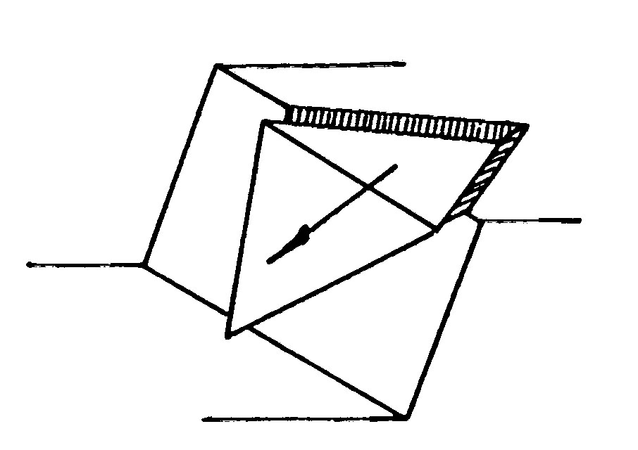
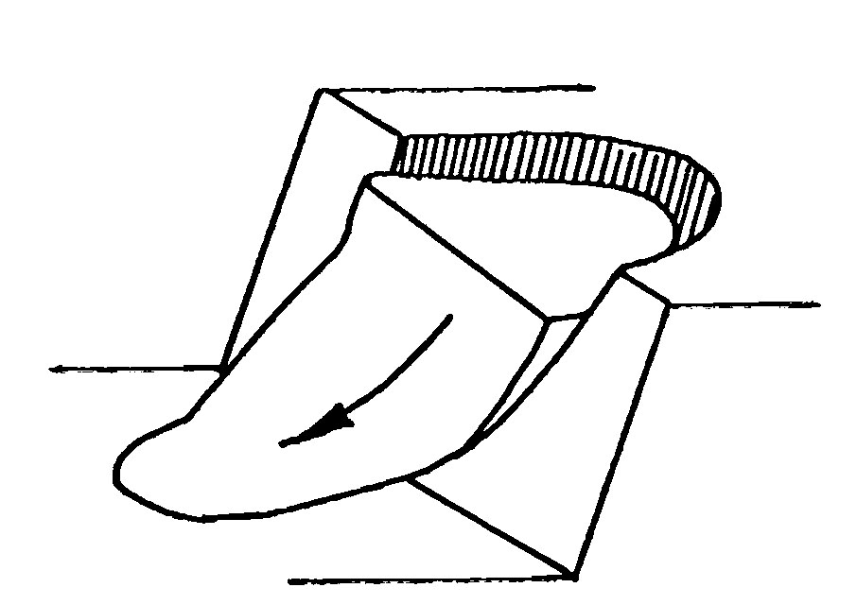
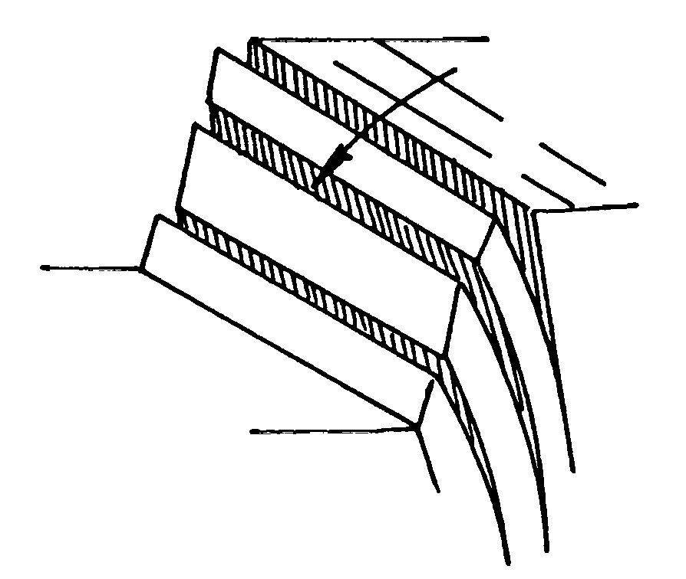
Modes of Slope Failure
Plane failure
Wedge failure
Circular failure
Toppling Failure

Slide 11

Assessment of Slope Stability
Numerical Modelling using FLAC2D Version5.0.
FLAC/Slope is a mini-version of FLAC that is designed specifically to perform factor-of-safety calculations for slope stability analysis, which is operated entirely from FLAC’s graphical interface.
FLAC/Slope provides an alternative to traditional “limit equilibrium” programs to determine factor of safety.
In contrast, it provides a full solution of the coupled stress/displacement, equilibrium and constitutive equations.
Given a set of properties, the system is determined to be stable or unstable, by automatically performing a series of simulations while changing the strength properties, the factor of safety can be found to correspond to the point of stability.

Slide 12
Input Parameters for the Numerical Modeling
Parametric studies of the past “case study” were conducted through numerical models (FLAC/Slope) to study the effect of cohesion (30-50 kPa) and friction angle (18°-26° at the interval of 2°) and slope angle was varied from 22° to 34°.
Rock Mass Density (kN/m3) | Cohesion (Kpa) | Angle of Internal Fricton | Slope Angle
16.8 | 40 | 23˚ | 28˚

Slide 13
Case study from Block – II, OCP, BCCL
Angle of repose for each lift = 37°
Overall height of dump = 90m
Each lift = 30m
Each bench width = 25m
Overall slope angle = 28°
 | Dump Foundation | Dump Material
Cohesion ( kPa) | 85 | 40
Friction Angle ( °) | 28 | 23
Bulk density ( kN/m³) | 19.6 | 16.8

Slide 14
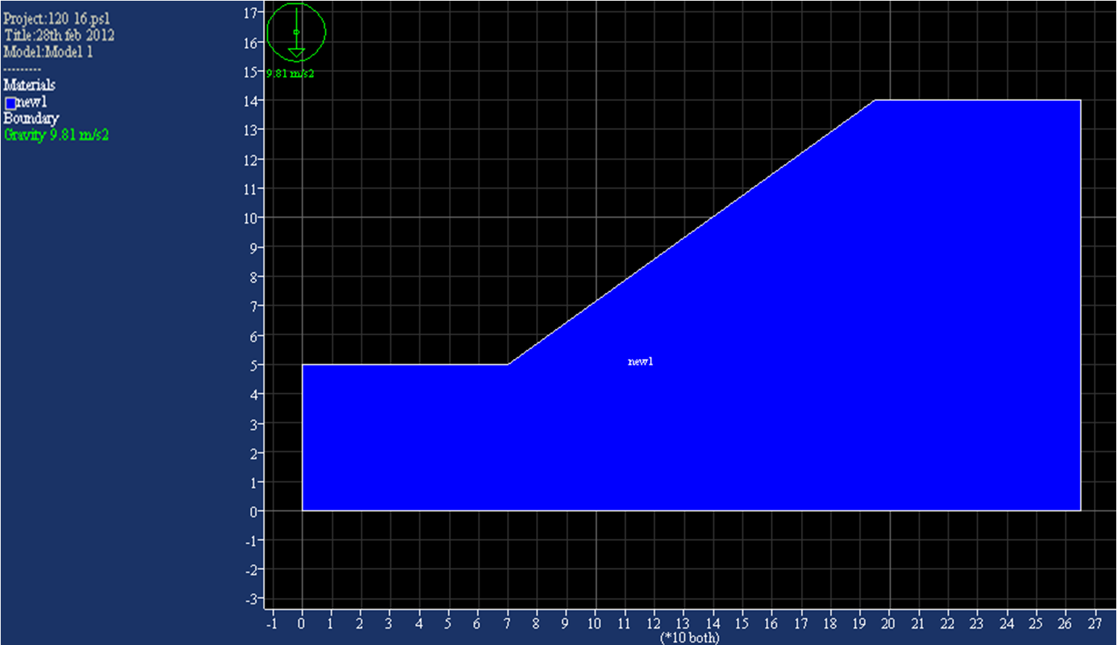
Slope Geometry of the Model
90 m
140 m
35•

Slide 15
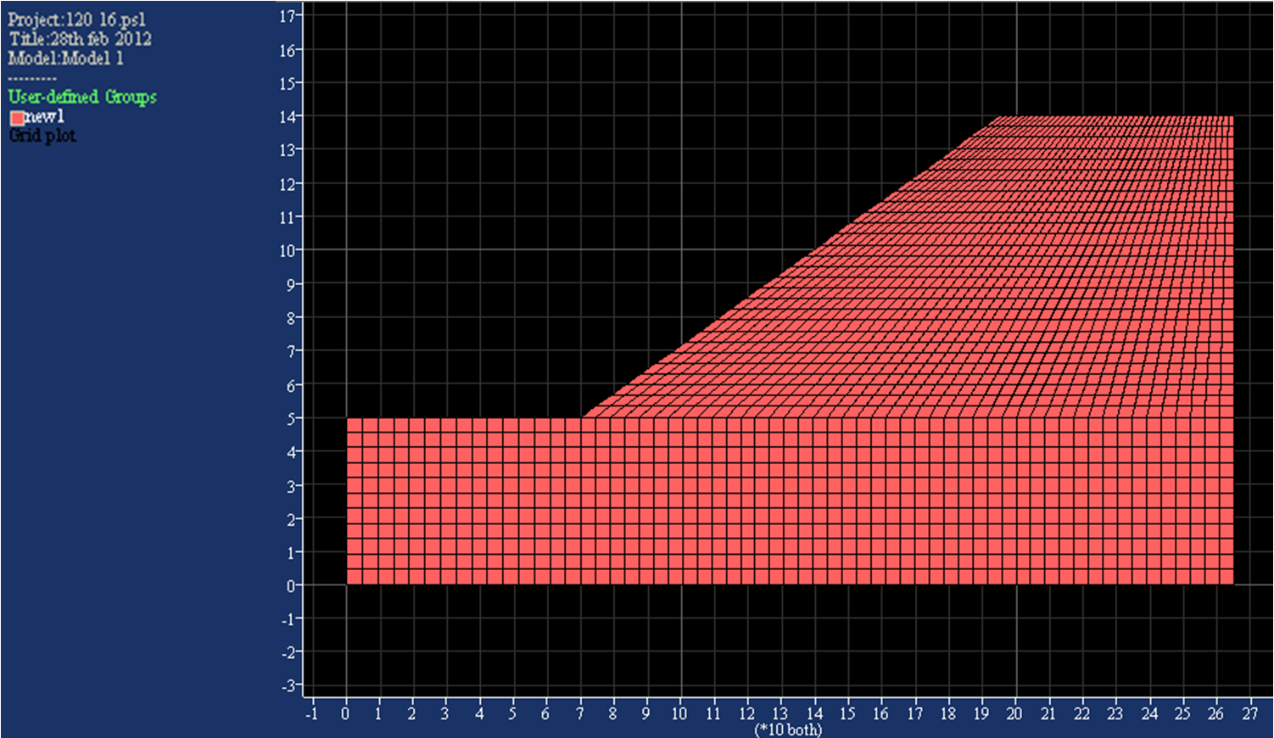
Fine grid mesh of the Model

Slide 16
Input Parameters for the Study of Models: -
Table 1.1 Safety factors for various slope angles (rise = 90m)
Sl. No. | Slope angle (°) | Cohesion (kPa) | Friction angle(°) | Factor of Safety
1. | 22 | 40 | 23 | 1.38
2. | 25 | 40 | 23 | 1.28
3. | 28 | 40 | 23 | 1.19
4. | 31 | 40 | 23 | 1.09
5. | 34 | 40 | 23 | 0.98

Slide 17
Fig.1a.) Rise = 90m, C= 40 kPa, Slope angle= 28°, Friction angle = 23° (FOS = 1.19)

Slide 18
Sl. No. | Friction Angle (°) | Bulk density (kN/m³) | Cohesion (kPa) | Factor of Safety
1. | 23 | 16.8 | 30 | 1.11
2. | 23 | 16.8 | 35 | 1.15
3. | 23 | 16.8 | 40 | 1.19
4. | 23 | 16.8 | 45 | 1.22
5. | 23 | 16.8 | 50 | 1.26
Variation of Factor of Safety with cohesion for same friction angle (23°) and density (16.8 KN/m³) at overall slope angle 28°

Slide 19
Sl. No. | Cohesion (kPa) | Bulk density (kN/m³) | Friction angle (°) | Factor of Safety
1. | 40 | 16.8 | 18 | 0.97
2. | 40 | 16.8 | 20 | 1.06
3. | 40 | 16.8 | 22 | 1.14
4. | 40 | 16.8 | 24 | 1.23
5. | 40 | 16.8 | 26 | 1.32
Variation of Factor of Safety with Friction angle for same Cohesion (40 KPa) and density (16.8 KN/m³) at overall slope angle 28°

Slide 20
Fig.1c.) Rise = 90m, C=40 kPa, Slope angle= 28°, Friction angle = 18° (FOS = 0.97)

Slide 21
Fig.1d.) Rise = 90m, C=50 kPa, Slope angle= 28°, Friction angle = 23° (FOS = 1.26)

Slide 22
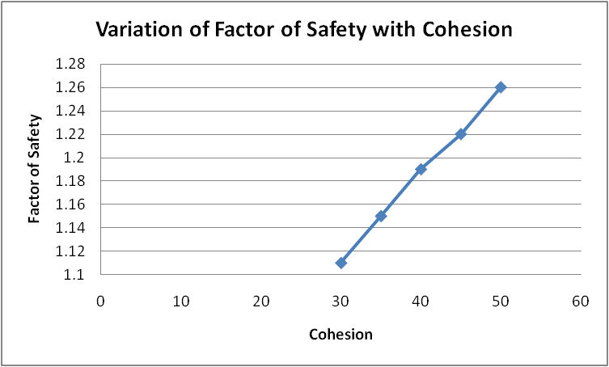
friction angle (23°)
density (16.8 kN/m³)
Fig :2.a. Variation of Factor of Safety with Cohesion

Slide 23
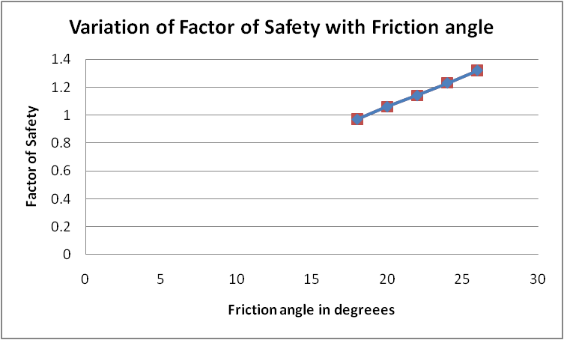
Cohesion (40 kPa)
Density (16.8 kN/m³)
Fig :2.b. Variation of Factor of Safety with Friction angle

Slide 24
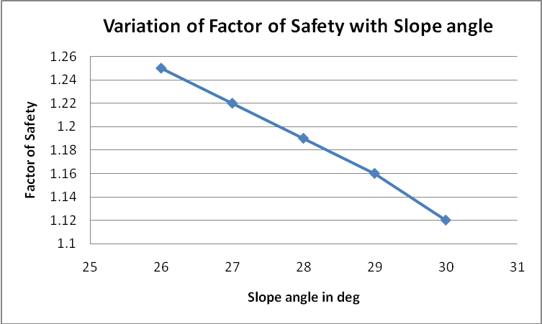
friction angle (23°)
cohesion ( 40 kPa )
Fig :2.c. Variation of Factor of Safety with Slope angle

Slide 25
Conclusion
1. From Fig 2.c, it is concluded that as the slope angle increases, the stability of the slopes decreases.
2. From fig 2.a and fig 2.b, it is concluded that as the cohesion and angle of internal friction increases, the factor of safety increases. As the cohesion increases, the binding property enhances which makes the slopes stable. High water content can weaken cohesion because abundant water both lubricates and adds weight to a mass. Moreover alternating expansion by wetting and contraction by drying of water reduces strength of cohesion.
3. While running the numerical model FLAC/Slope it was observed that factor of safety changes with change in the resolution of the numerical mesh (coarse, medium and fine). In case of coarse mesh the factor of safety is quite approximate, while in fine mesh the factor of safety converges to the nearest possible value making it more accurate. However, calculation in coarse mesh is faster than in fine mesh. So depending upon the requirement and time availability of modeller, the mesh has to be selected.

Slide 26
Based on the various analyses, following recommendations have been made to ensure stability of the slope
a) The slope of the existing dumping yard do not exhibit any major failure
b) The existing slope have safety factor in the range of 1.02 to 1.35 with slope angles between 23º and 33º.
c) The safety factor with the proposed angle of dump slope of 28⁰ is 1.19.

Slide 27
FUTURE SCOPE
Software can be used to improve factor of safety by varying different parameters.
If factor of safety can’t be improved by varying parameter then other techniques like providing support, proper drainage systems etc should be implemented.
Software can be used to determine stability of pit as well as dump.

Slide 28
REFERENCES
Abramson et al. (2001), Slope stability and stabilization 2nd edition.
Roy, I (1999). 'Influence of Geo-engineering Parameters on the Stability of Dumps, (PhD Dissertation)'. Indian Institute of Technology, Kharagpur, India.
Das, S. K. (2001). 'Problems of Highwall and Spoil Dump Stability and Various Preventive Measures in Highly Mechanized Opencast Mines'. The Indian Mining and Engineering Journal , 63pp.
Hoek, E & Bray. Rock Slope Engineering
Omraci, Kamel et.al, Stability analysis of lateritic waste deposits,2003
Stanciucu, Mihaela, Evaluation of waste embankment slope stability: Valea Manastirii, Gorj, Romania, 2005.
T. Cameron Kenny, Stability of slopes in over burden excavations
Itasca. (2001), “FLAC Version 5.0. Manual”, Minneapolis: ICG.
http://www.rocscience.com
http://geoinfo.usc.edu/bardet/reports/Journal_papers/5simplex.pdf
Journal on Stability evaluation and optimal excavated design of rock slope at Antaibao open pit coal mine, China by M.C. He, J.L. Feng, X.M. Sun
http://www.wikipedia.com

